Slide 1
Introduction to Embedded System
Home Automation
Mentor Students
Dr. Bassem Alhalabi Mohammed Alsanea
Garvin Casinillo
Mike Hus

Slide 2
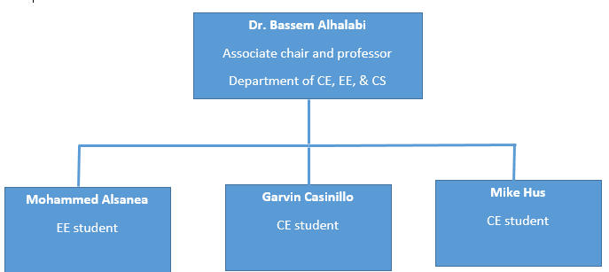
Organization Chart

Slide 3
Home Automation Tasks
Temperature Controlled Fan
Motion Activated Lighting System
Keypad Enabled Security System

Slide 4
Implementation
Temperature sensor
PIR (Motion sensor) controls a light.
Servo controlled by a keypad

Slide 5
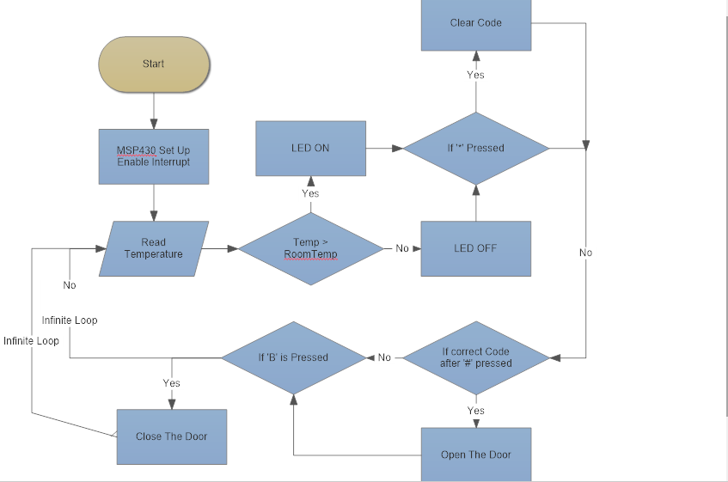
Flow Chart Main

Slide 6
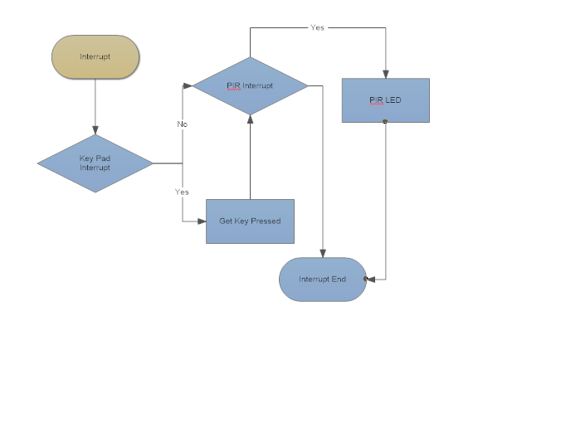
Flow Chart Interrupt

Slide 7
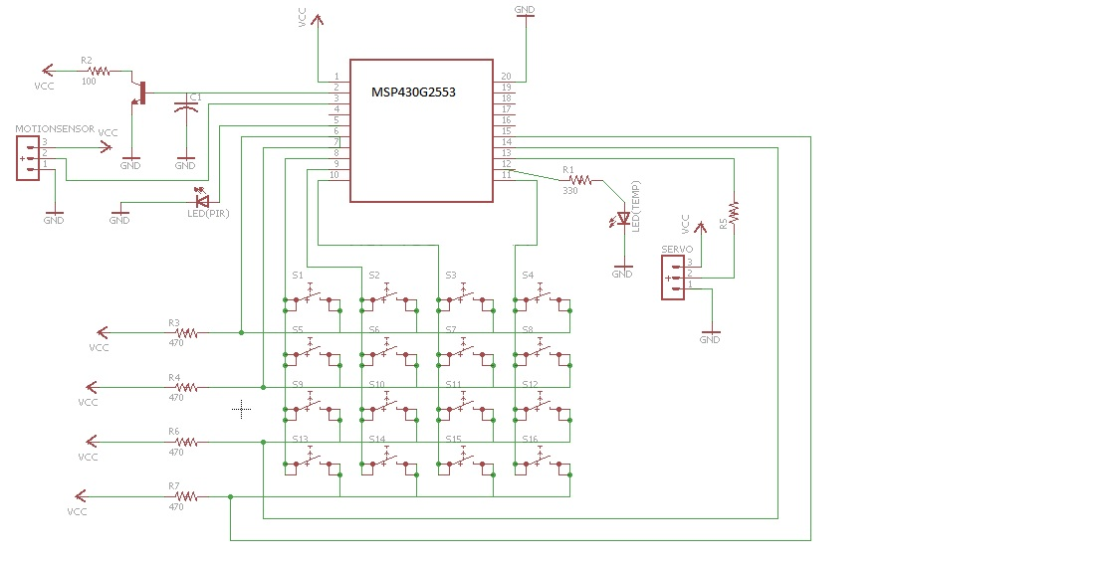
Schematic

Slide 8
Present the Project

